Slide 1
COMP261 Algorithms and Data Structures
Data Compression 2:
Lempel-Ziv Coding
Fang-Lue Zhang

Slide 2
Data/Text Compression
Reducing the memory required to store some information.
Huffman coding minimised the number of bits for each symbol.
Perhaps we could do better by looking at sequences of symbols?
Original text/image/sound
compress
compressed
text/image/sound

Slide 3
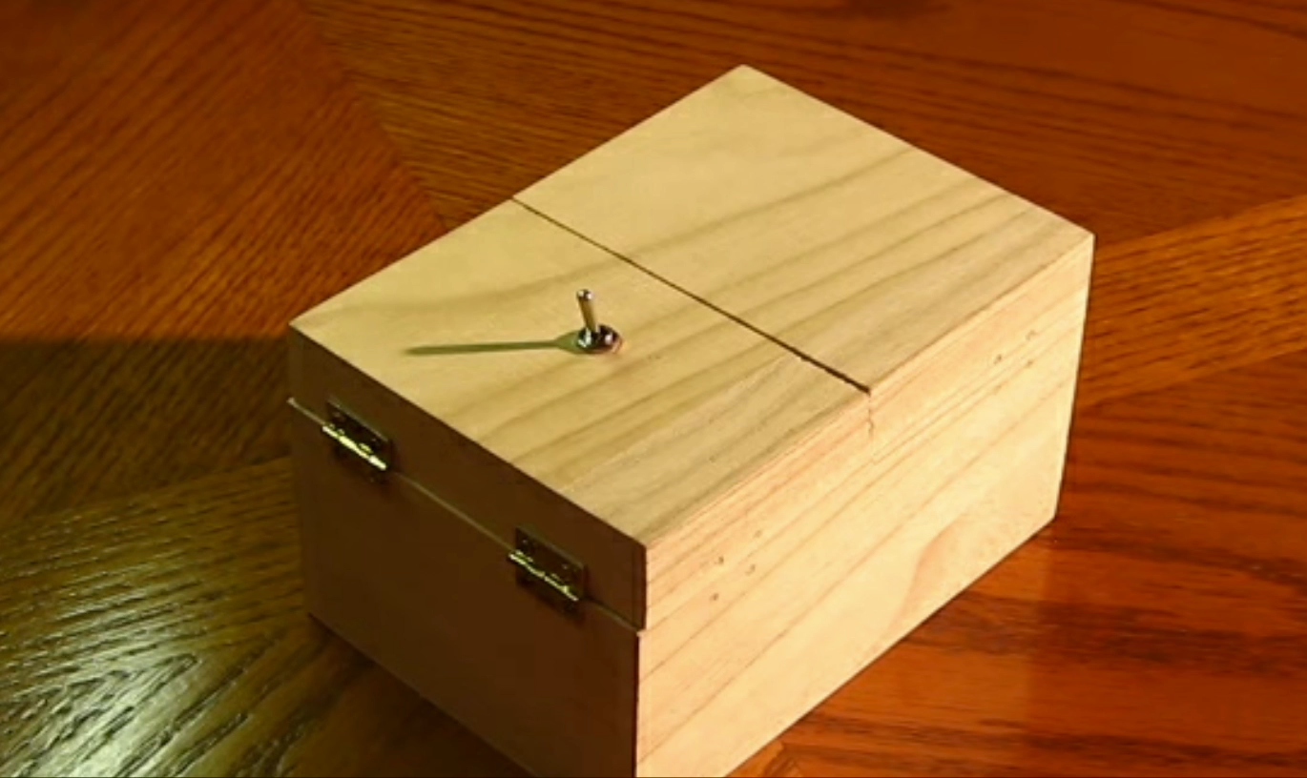
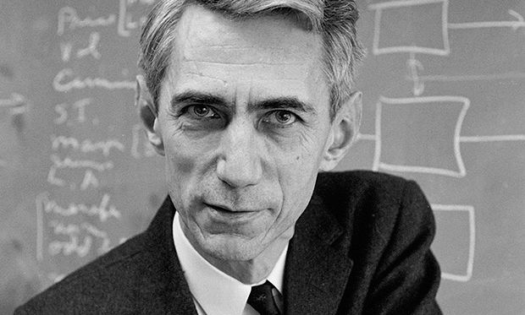
Shannon, and information theory
Claude Shannon
“…kept a box on his desk called the "Ultimate Machine". Otherwise featureless, the box possessed a single switch on its side. When the switch was flipped, the lid of the box opened and a mechanical hand reached out, flipped off the switch, then retracted back inside the box.”
“This duality can be pursued further and is related to a duality between past and future and the notions of control and knowledge. Thus we may have knowledge of the past but cannot control it; we may control the future but have no knowledge of it.”
Notes:
Shannon is the founder of information theory, father of the information age

Slide 4
predictable structure → shorter codes?
Shannon’s source coding theorem: the optimal code length for a symbol is –log₂P, where P is the probability of the input symbol. The average of this, over the whole alphabet, is called the entropy, H.
If P was “flat” (all letters equally likely), H=4.75 bits, for English
With the actual P, it drops a bit to 4.2 bits/char. You can try it here.
but that ignores the fact it’s a sequence.
Fr xmpl, y cn prbbly gss wht ths sntnc sys, vn wth ll f th vwls mssng. Tht ndcts tht th nfrmtn cntnt cn b xtrctd frm th rmnng smbls.
Aoccdrnig to rscheearch at Cmabirgde Uinervtisy, it deosn’t mttaer in waht oredr the ltteers in a wrod are, the olny iprmoetnt tihng is taht the frist and lsat ltteer be at the rghit pclae. The rset can be a ttoal mses and you can sitll raed it wouthit porbelm. Tihs is bcuseae the huamn mnid deos not raed ervey lteter by istlef, but the wrod as a wlohe. Amzanig huh?
Notes:
For example, I can probably guess what this sentence says, even with all of the vowels missing. That indicates that the information content can be extracted from the remaining symbols.
According to research at Cambridge University, it doesn't matter in what order the letters in a word are, the only important thing is that the first and last letter be at the right place. The rest can be a total mess and you can still read it without problem. This is because the human mind does not read every letter by itself, but the word as a whole. Amazing, huh?

Slide 5
predictable structure → shorter codes
Digrams/bigrams and trigrams? In English the most common are:
Digrams Trigrams
EN ENT
RE ION
ER AND
NT ING
TH IVE
ON TIO
IN FOR
TR OUR
AN THI
OR ONE
Entropy if you use trigrams drops to about 2.6 bits/char
So what’s the entropy if you go to n-grams, and let n get “big”?
it ends up somewhere between 0.6 and 1.3 bits/char !!
can we design a code to reach this? how?
the “Shannon limit”

Slide 6
Different approach: Run Length Encoding
If data contains lots of runs of repeated symbols, it may be efficient to store as (count, symbol) pairs.
E.g. #1: could use two bytes for each character: 1 byte for the count (up to 256), and 1 byte for the character aaabbaaaaaaapaa → 3a2b6a1p2a
E.g. #2: could use 6 bits to store black and white image data: 5 bits for the count, and 1 bit to say what is repeated 111111110000001111111111111 → 010001 001100 011011
Poor for: abcabcabbcabcabaabcabcccababcabc…
Poor for: 01011101110010101010101010101….

Slide 7
Lempel-Ziv
Lossless compression.
LZ77 = simple compression, using repeated patterns
basis for many later, more sophisticated compression schemes.
Key idea:
If you find a repeated pattern, replace later ones by a link to the first:
a contrived text containing riveting contrast
a contrived text[15,5] ain[2,2] g [22,4] t[9,4][35,5] ast
(Note: This ignores patterns of length 1 – they are included later.)
Notes:
Compressed text revealed as step through animation:
a contrived text[15,5] ain[2,2] g [22,4] t[9,3][35,5] as[12,4]

Slide 8
Lempel-Ziv
How can we distinguish pointers from ordinary characters?
Store text as triples:
[offset,length,symbol] where symbol is just the next symbol.
so if there’s no repetition to reference: just [0,0,symbol]
To limit size of offset and length, we:
limit the size of the window to left of current position in which we look for a match, and
limit the distance ahead we look in the input for a match.

Slide 9
Lempel-Ziv Example
a contrived text containing riveting contrasting …
[0,0,a] [0,0, ] [0,0,c] [0,0,o] [0,0,n] [0,0,t]
[0,0,r] [0,0,i] [0,0,v] [0,0,e] [0,0,d]
→→→a contrived
[10,1,t] → _ t [4,1,x] → e x [3,1, ] → t _ [15,4,a] → cont a [15,1,n] → i n [2,2,g] → in g [11,1,r] → _ r [22,3,t] → ive t [9,4,c] → ing_ c [35,4,a] → ontr a
no repeats, so all at just [0,0,symbol]
so far
notice that including matches of length 1 changes the encoding
This takes 69 bytes to store 48 characters - assuming that offset, length and character each take one byte. Would improve with longer text.

Slide 10
Lempel-Ziv 77
skljsadf lkjhwep oury d dmsmesjkh fjdhfjdfjdpppdjkhf sdjkh fjdhfjds fjksdh kjjjfiuiwe dsd fdsf sdsa
Outputs a string of tuples:
[offset, length, nextCharacter] or [0,0,character]
Moves a cursor through the text one character at a time
cursor points at the next character to be encoded.
Drags a "sliding window" behind the cursor.
searches for matches only in this sliding window
Expands a lookahead buffer from the cursor
this is the string it tries to match in the sliding window.
Searches for a match for the longest possible lookahead
stops expanding when there isn't a match
Insert triple of match point, length, and next character

Slide 11
Lempel-Ziv 77 – high level
cursor ← 0; windowSize ← 100 // some suitable size
while cursor < text.length-1:
look for longest prefix of text[cursor .. text.length-1]
in text[max(cursor-windowSize,0) .. cursor]
if found, add [offset,length,text[cursor+length]] to output
else add [0, 0, text[cursor]] to output
advance cursor by length+1
We can use various approaches to find that longest-matching-substring:
Brute force: Look for longest match at each position in window
KMP, or Boyer Moore…

Slide 12
Lempel-Ziv 77 – coding, a first attempt
cursor ← 0
windowSize ← 100 // some suitable size
while cursor < text.size
length ← 1
prevMatch ← 0
loop
match ← stringMatch( text[cursor.. cursor+length], text[((cursor<windowSize)?0:cursor-windowSize) .. cursor])
if match succeeded then:
prevMatch ← match
length ← length + 1
else:
output( [a value for prevMatch,
length - 1, text[cursor+length - 1]])
cursor ← cursor + length
break
This looks for an occurrence of text[cursor..cursor+length] in text[start..cursor-1], for increasing values of length, until none is found, then outputs a triple.
This is pretty wasteful – we know there is no match before prevMatch, so there’s no point looking there again! Probably better starting from prevMatch?
Or (maybe) find longest match starting at each position in window and record longest?
However: (cursor – windowSize)
should never point before 0,
and (cursor + length) mustn't
go past end of text

Slide 13
Decompression
a_contrived_text_containing_riveting_contrasting_t
➔
[0,0,a][0,0,_][0,0,c][0,0,o][0,0,n][0,0,t][0,0,r][0,0,i][0,0,v][0,0,e][0,0,d][10,1,t]
[4,1,x][3,1,_][15,4,a][15,1,n][2,2,g][11,1,r][22,3,t][9,4,c][35,4,a][0,0,s][12,5,t]
so we can just decode each tuple in turn:
cursor ← 0
for each tuple
if [0, 0, ch ] : output[cursor++] ← ch
elif [offset, length, ch ] :
for j = 0 to length-1
output [cursor++] ← output[cursor-offset ]
output[cursor++] ← ch

Slide 14
Lempel Ziv – note that…
Encoding is expensive, decoding is cheap
Many improvements/variants have been proposed
See Wikipedia and other online summaries
e.g.: could use two types of output value:
(offset, length) pair for repeated sequence,
character for non-repeat
How can we distinguish them?
Can be used in conjunction with Huffman coding.

Slide 15
We need a string-searching algorithm
Knuth-Morris-Pratt visualization (also Huffman, many others): https://people.ok.ubc.ca/ylucet/DS/Algorithms.html
If you’re interested in Boyer-Moore: https://dwnusbaum.github.io/boyer-moore-demo/
The “Moore” in Boyer-Moore has a nice interactive demos of both Knuth-Morris-Pratt and Boyer-Moore algorithms: http://www.cs.utexas.edu/users/moore/best-ideas/string-searching/

